Slide 1
WELCOME TO FRONT-DEV CLASS with Mr. Japhet M
Html-css-javascript

Slide 2
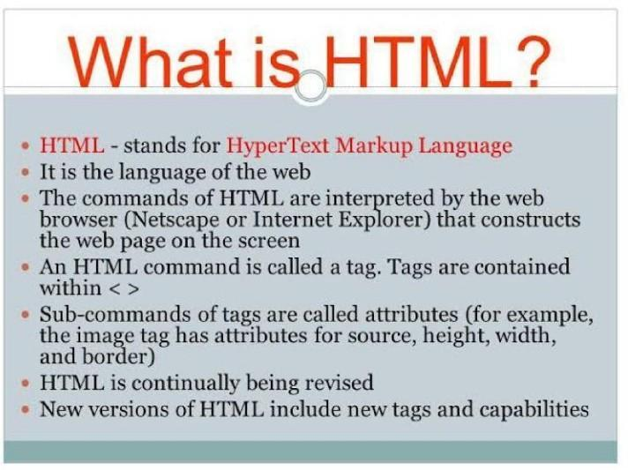

Slide 3
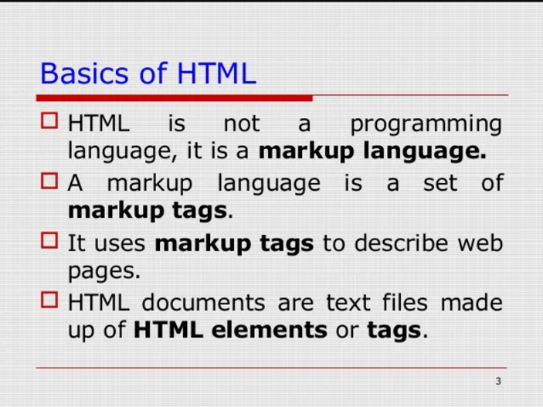
HTML BASICS

Slide 4
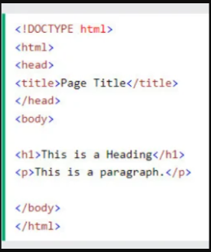
HTML STRUCTURE

Slide 5
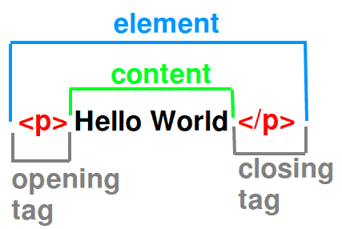

Slide 6
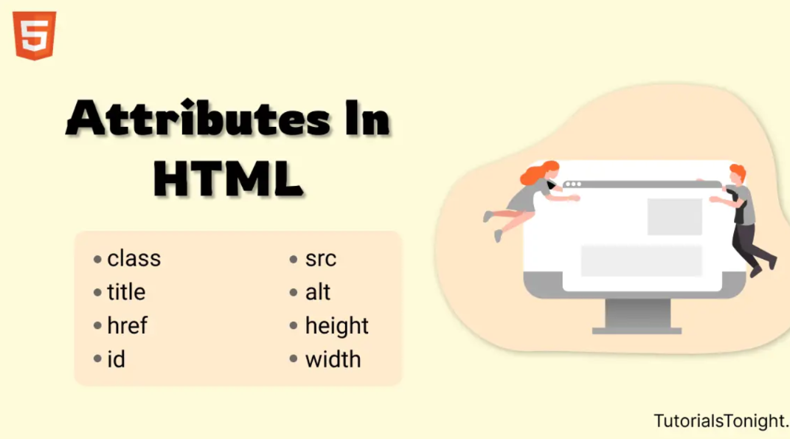
HTML ATRRIBUTES

Slide 7
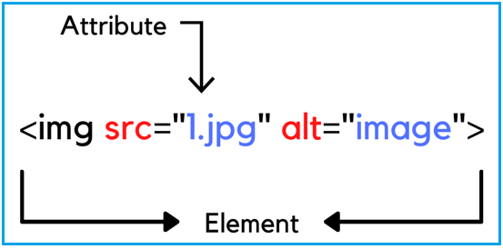

Slide 8
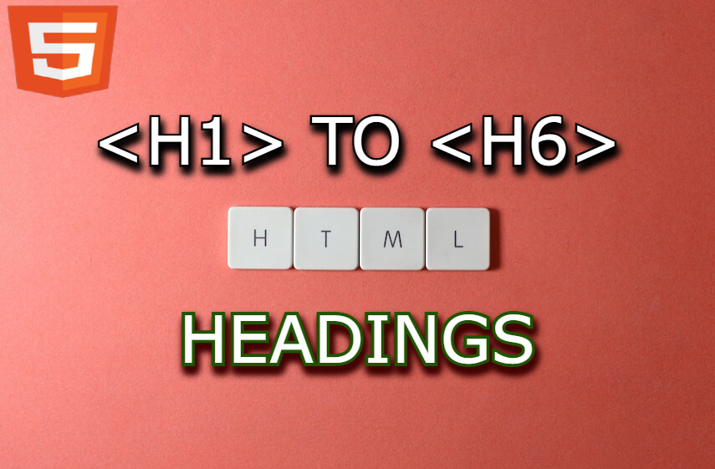

Slide 9
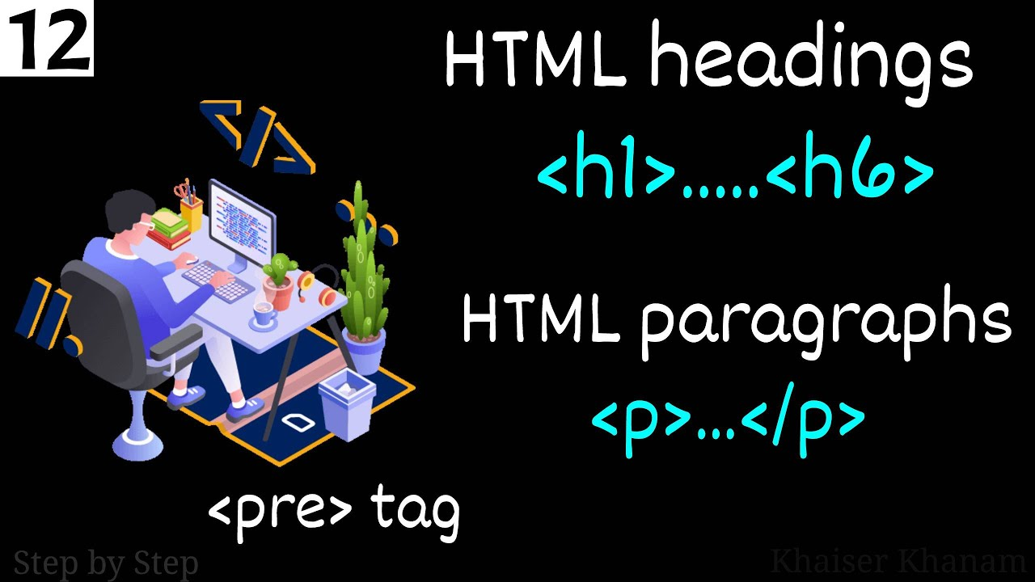

Slide 10
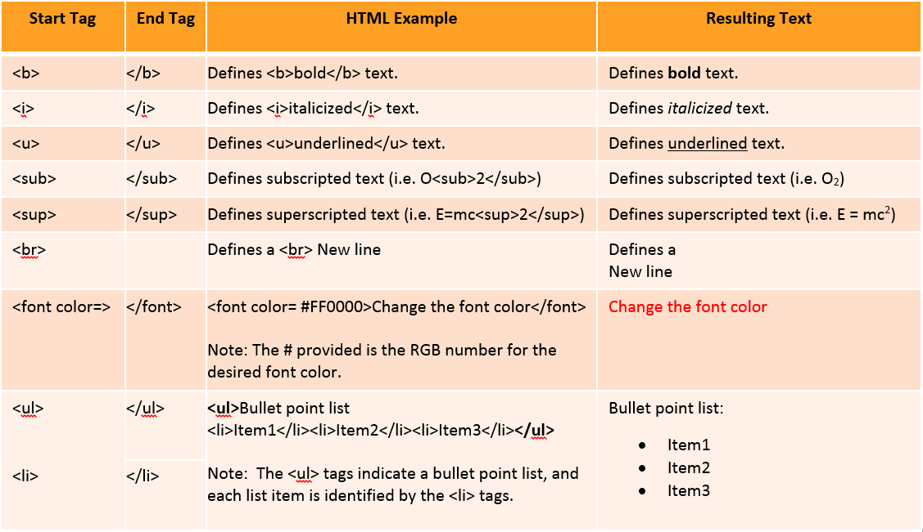

Slide 11
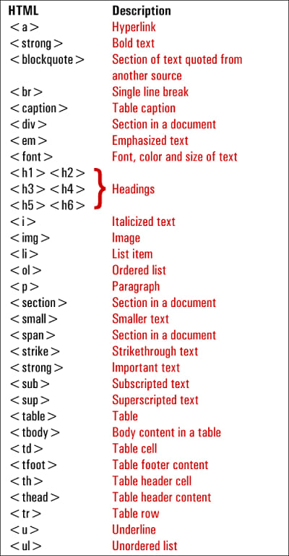
Element Tags

Slide 12
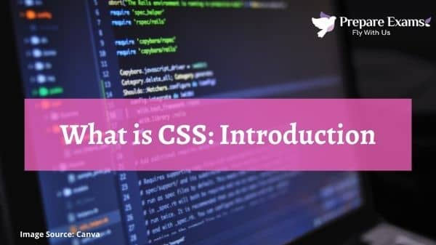

Slide 13
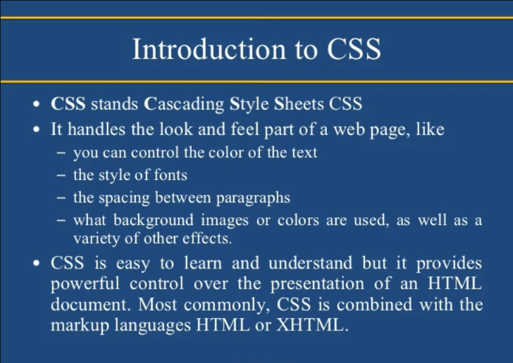

Slide 14
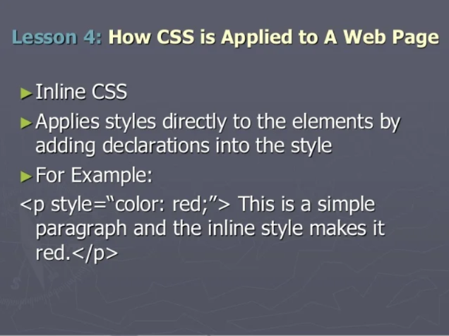
APPLYING INLINE CSS

Slide 15
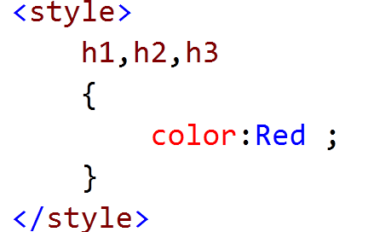
INTERNAL CSS

Slide 16
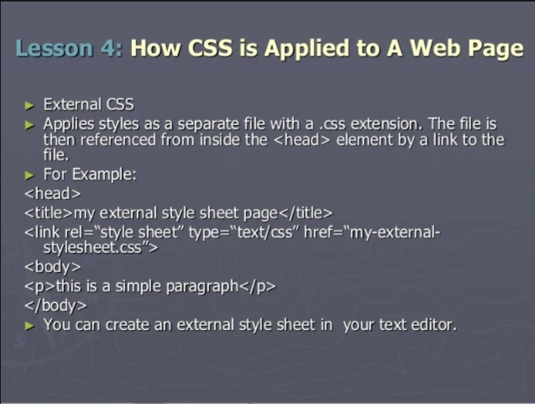
EXTERNAL CSS

Slide 17
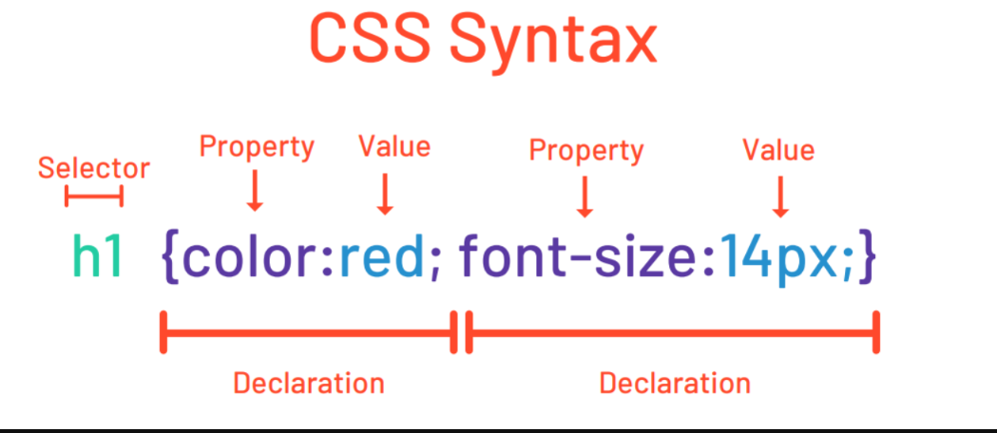
CSS SYNTAX

Slide 18
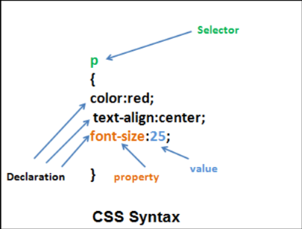
CSS SYNTAX

Slide 19
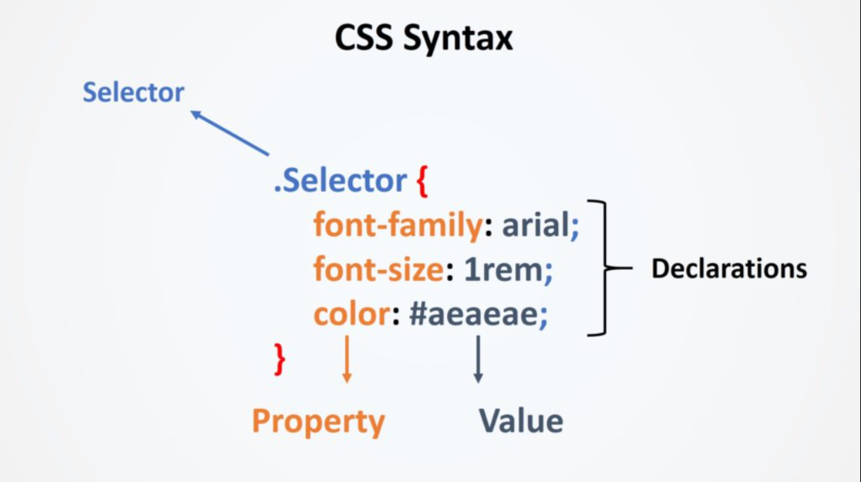
CSS CLASS SELECTOR SYNTAX

Slide 20
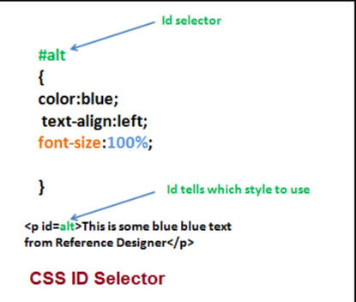
CSS ID SELECTOR

Slide 21

CSS COMMENT

Slide 22
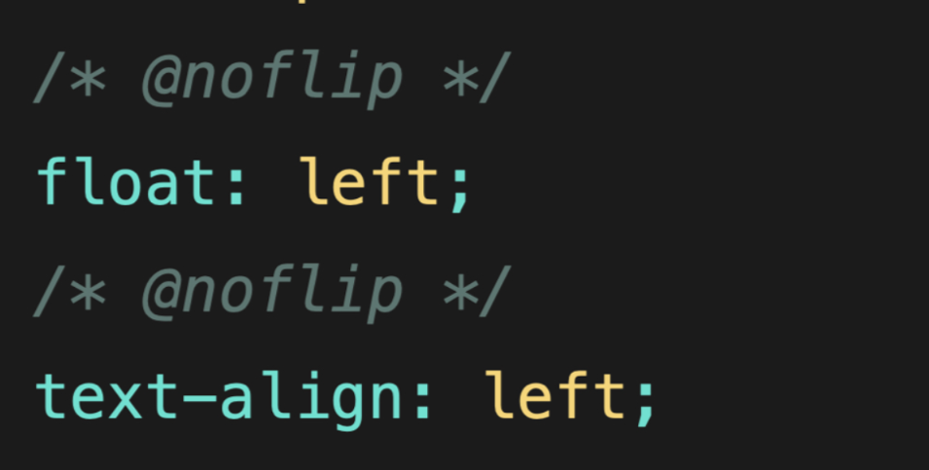
COMMENT

Slide 23
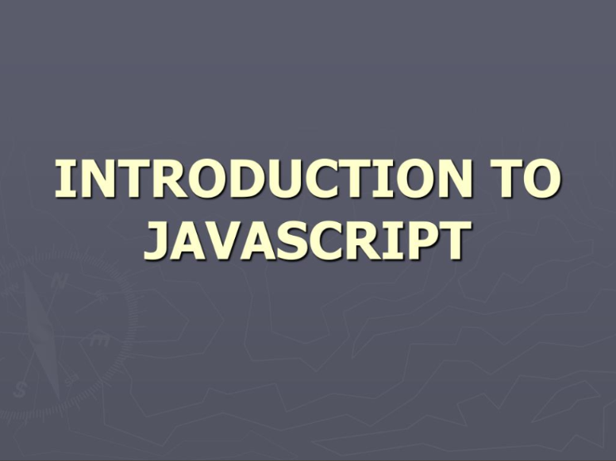
JAVASCRIPT

Slide 24
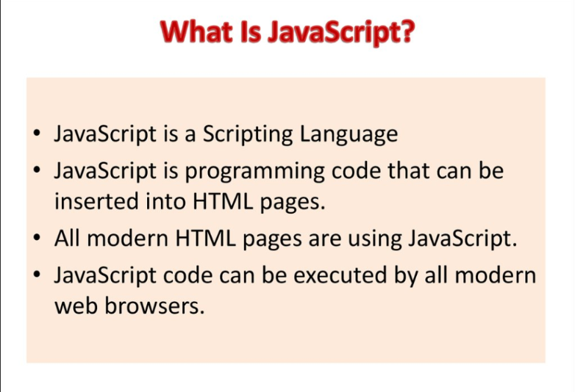
JAVASCRIPT

Slide 25
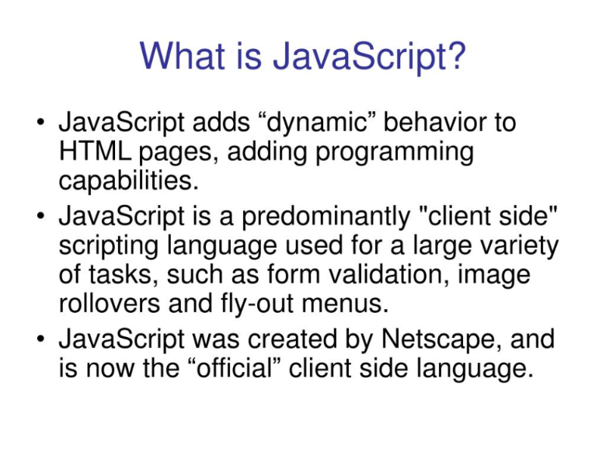
JS

Slide 26
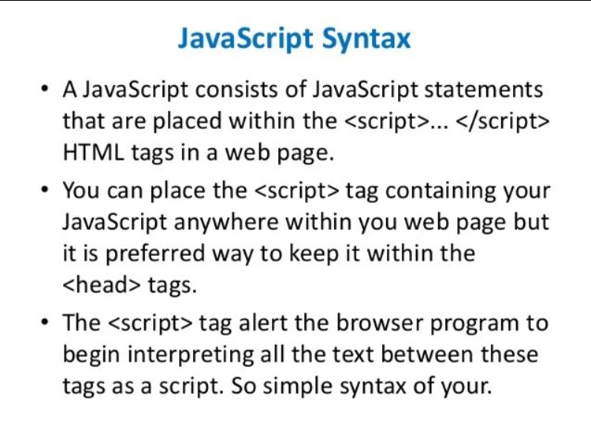
JS SYNTAX

Slide 27
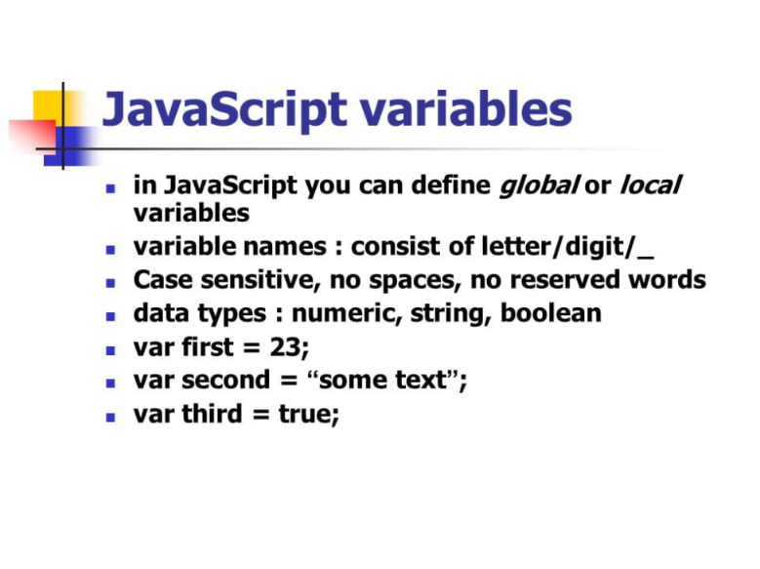
JS VARIABLES

Slide 28
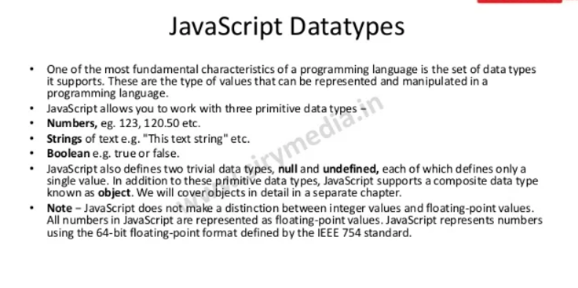
JS DATATYPES

Slide 29
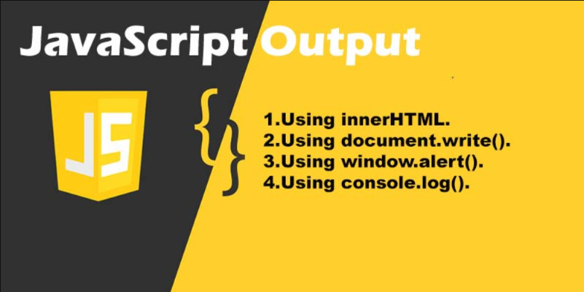
JS OUTPUT

Slide 30
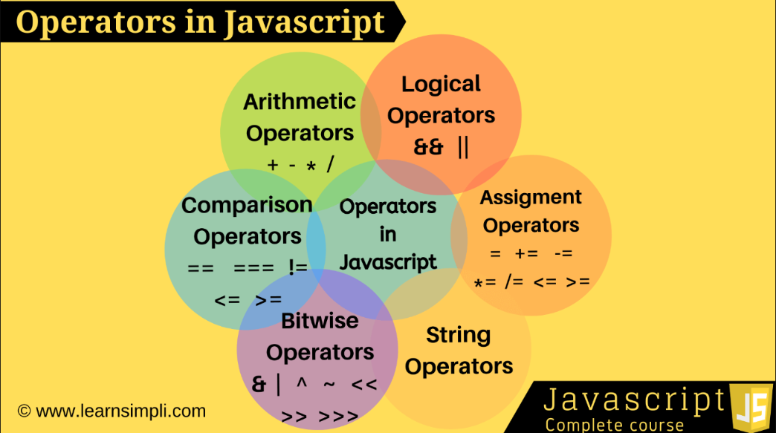
OPERATORS

Slide 31
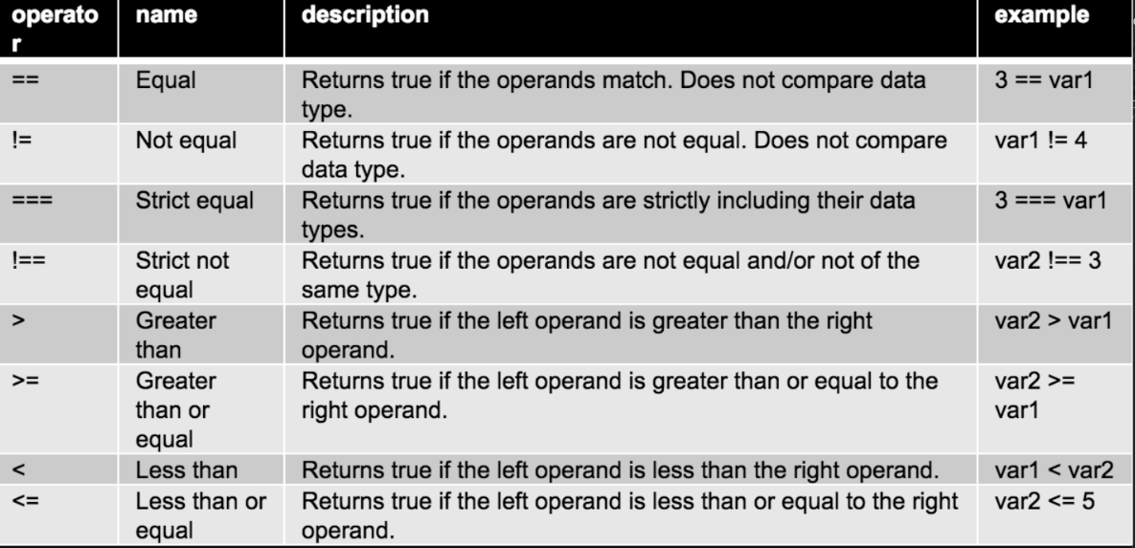
JS OPERATORS

Slide 32
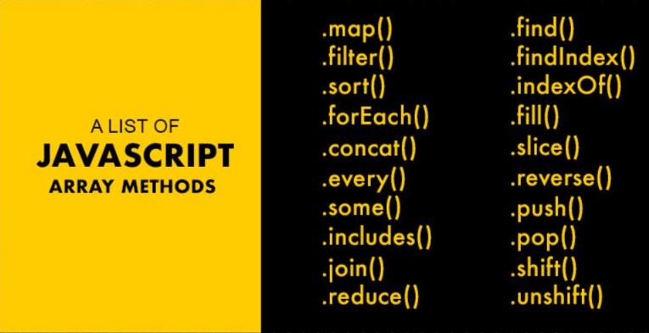
ARRAY METHODS

Slide 33
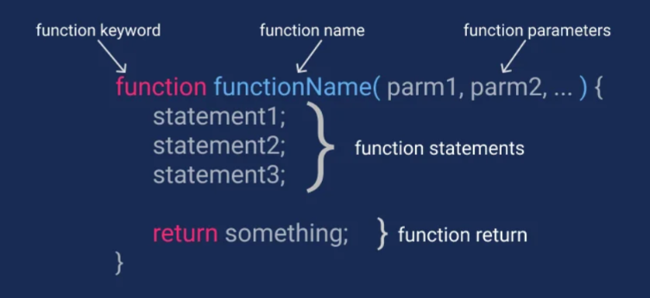
JS FUNCTION

Slide 34
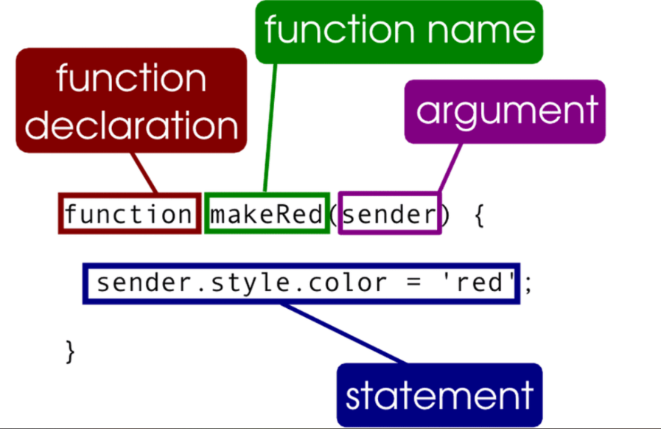
JS FUNCTION

Slide 35
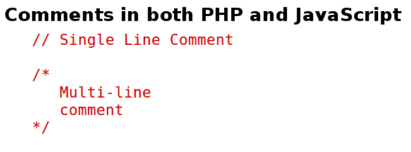
JS COMMENT

